Slide 1


SIMATS ENGINEERING
SAVEETHA INSTITUTE OF MEDICAL AND TECHNICAL SCIENCES
MLA0301 - REINFORCEMENT LEARNING
Advanced Policy Optimization Techniques in Deep Reinforcement Learning
Guided by:
Dr. Senthil G A
Presented by:
S. Sirivally (192472371)

Slide 2
Advanced Policy Optimization in Deep Reinforcement Learning
Why policy optimization?​
Three methods​
STATE s
POLICY π(a|s)
Instead of storing only action values, policy-based methods directly learn a policy π(a|s). They are useful when action choices are large or continuous.​ Goal: improve expected cumulative reward while keeping learning stable.​
TRPO​ Safe, constrained updates​ ​ PPO​ Clipped, practical updates​ ​ DDPG​ Continuous control​
ACTION a
REWARD r

Slide 3
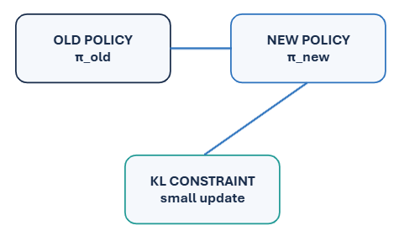
TRPO — Trust Region Policy Optimization
Stable policy updates by limiting how far the new policy moves
Core idea
TRPO maximizes the expected improvement of a new policy while constraining the change from the old policy.​ ​ The constraint is based on KL divergence:​ ​ KL(π_old || π_new) ≤ δ​ ​ This prevents destructive, overly large updates.​
Why useful?
✓ Stable learning ✓ Reduces policy collapse ✓ Strong theoretical motivation ✗ More complex optimization ✗ Higher computation

Slide 4
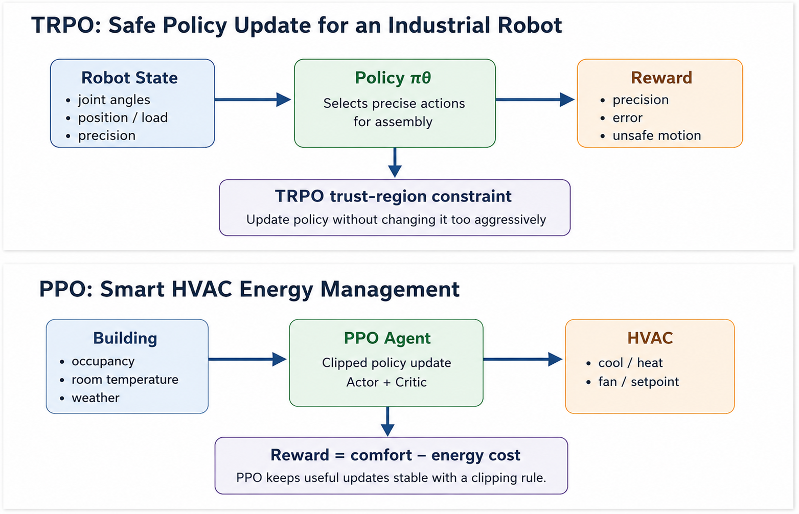
TRPO Example — Autonomous Robot Navigation
A policy update should improve navigation without suddenly changing robot behavior
Example setup
State: • robot position • distance to goal • obstacle proximity Actions: • move left/right/forward Reward: +10 goal reached −5 collision −1 unnecessary step
Sensors STATE
TRPO POLICY
MOTOR ACTION
ROBOT ENVIRONMENT
TRPO behavior
Update the policy only when the new policy remains within the trust region → safer and more stable improvement.

Slide 5
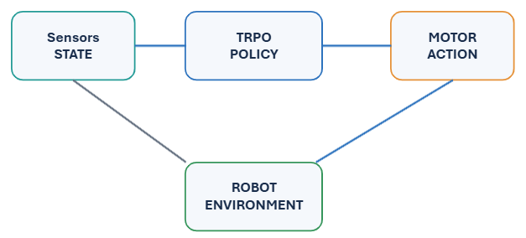
PPO — Proximal Policy Optimization
A simpler alternative that keeps policy updates close to the previous policy
Key concept
PPO uses a clipped probability ratio: r(θ) = πθ(a|s) / πold(a|s) The objective clips this ratio to a safe interval such as [1−ε, 1+ε]. Typical ε ≈ 0.1–0.2.
Why PPO is popular
Good stability + simpler implementation + efficient mini-batch training.

Slide 6
PPO Example — CartPole
ACTOR POLICY
ACTION
Learning to keep a pole balanced by improving the policy over repeated episodes
MDP for CartPole
State: cart position, cart velocity, pole angle, pole velocity Actions: left / right Reward: +1 for every time step the pole remains balanced Goal: maximize episode length.
STATE
CARTPOLE

Slide 7
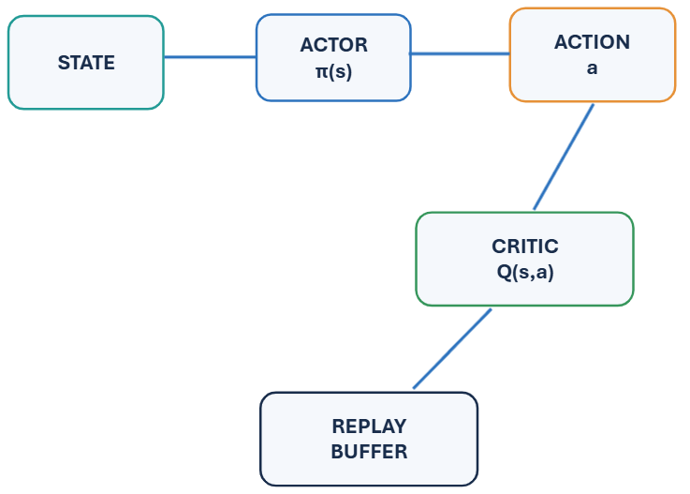
DDPG — Deep Deterministic Policy Gradient
Actor–critic learning for continuous action spaces
When to use DDPG?
Ideal when actions are continuous rather than discrete. Examples: • robot joint torque • steering angle • throttle level • portfolio allocation weights DDPG combines deterministic policy gradients with an experience replay buffer and target networks.
Key components
Actor → chooses action Critic → evaluates action Replay → improves sample efficiency Target networks → stability

Slide 8
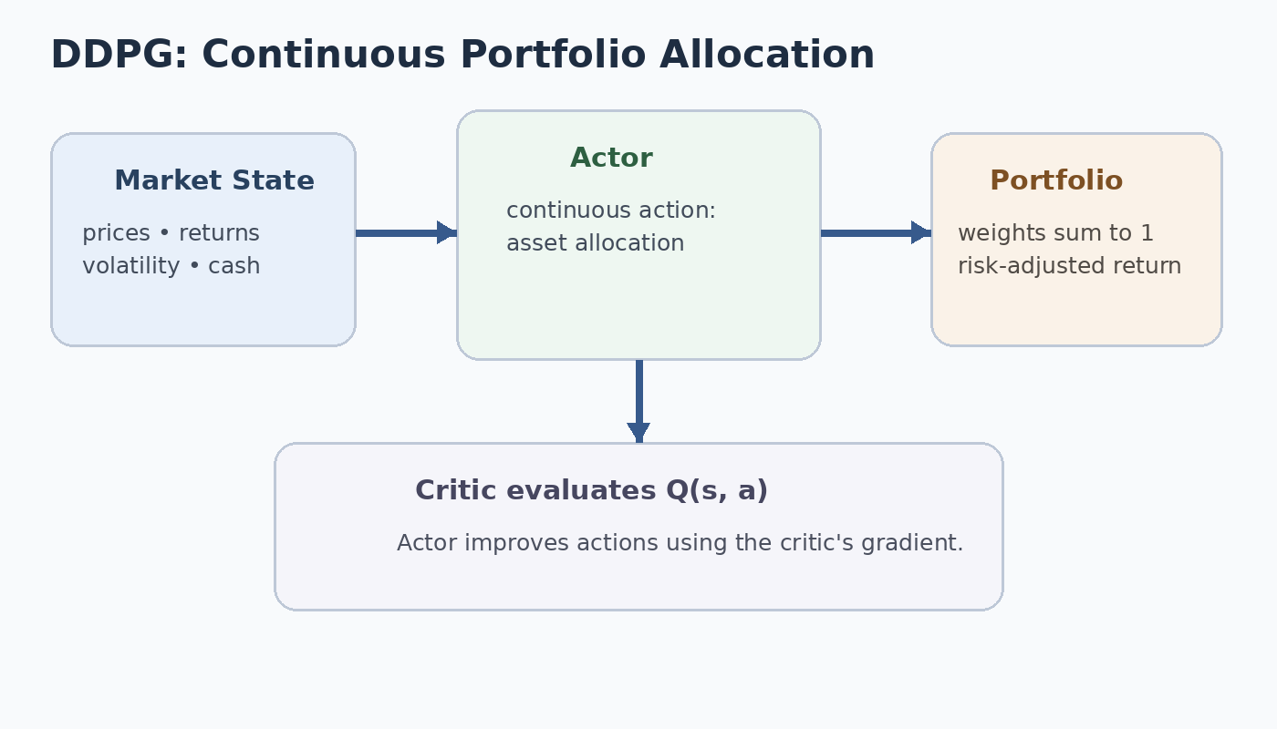
DDPG Example — Robotic Arm Control
Continuous motor control: choose precise joint movements instead of only left/right actions
Problem definition
State: • joint angles • joint velocities • target position Action: continuous motor torque for each joint Reward: +10 near target −distance to target −collision penalty −energy cost
Main advantage
DDPG can learn fine-grained continuous control where discrete-action methods are less natural.
Visual takeaway: TRPO → safe updates | PPO → stable clipped updates | DDPG → continuous control

Slide 9
Comparison focused on convergence, stability and efficiency
Criterion | TRPO | PPO | DDPG
Action space | Discrete / continuous | Discrete / continuous | Continuous
Convergence | Stable, but slower | Fast and reliable | Can be unstable
Stability | ★★★★★ | ★★★★☆ | ★★★☆☆
Sample efficiency | Good | Very good | Good with replay
Computation | High | Moderate | Moderate
Bottom line
PPO is usually the best classroom and practical default.
TRPO is valuable when update stability is the priority.
DDPG is the natural choice when actions are continuous.
Main strength
Trust-region safety
Practical stability
Continuous control
8

Slide 10
Conclusion — Choosing the Right Policy Optimizer
TRPO
PPO
DDPG
Best for stable, conservative policy updates. Key idea: constrain policy change using KL divergence. Use when stability is more important than implementation simplicity.
Best general-purpose choice. Key idea: clip policy updates so learning remains stable without TRPO's heavier optimization. Excellent balance of convergence, stability and efficiency.
Best for continuous control. Key idea: actor chooses continuous actions while critic evaluates them. Useful in robotics, control and resource allocation.
9

Slide 11
